Slide 1
Motifs and Moccasins
Jazmyne, Damaris, Alicia, Rashini
Notes:
jazmyne

Slide 2
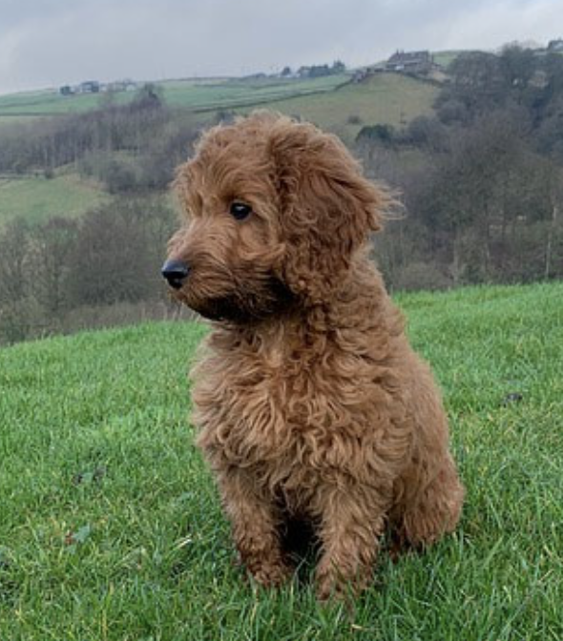
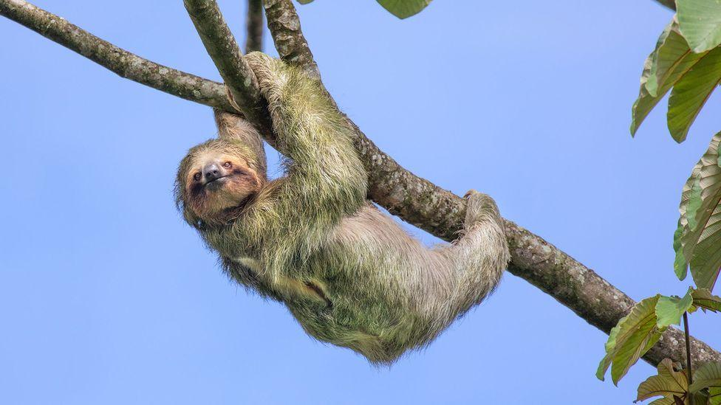
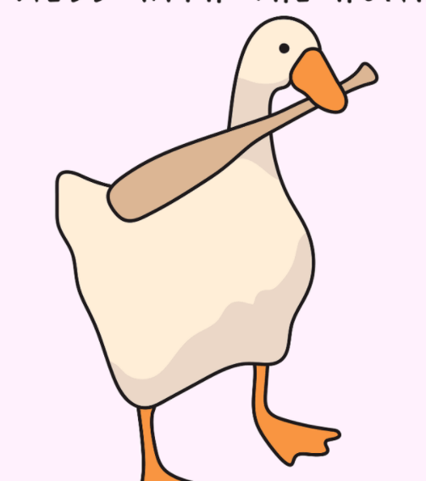
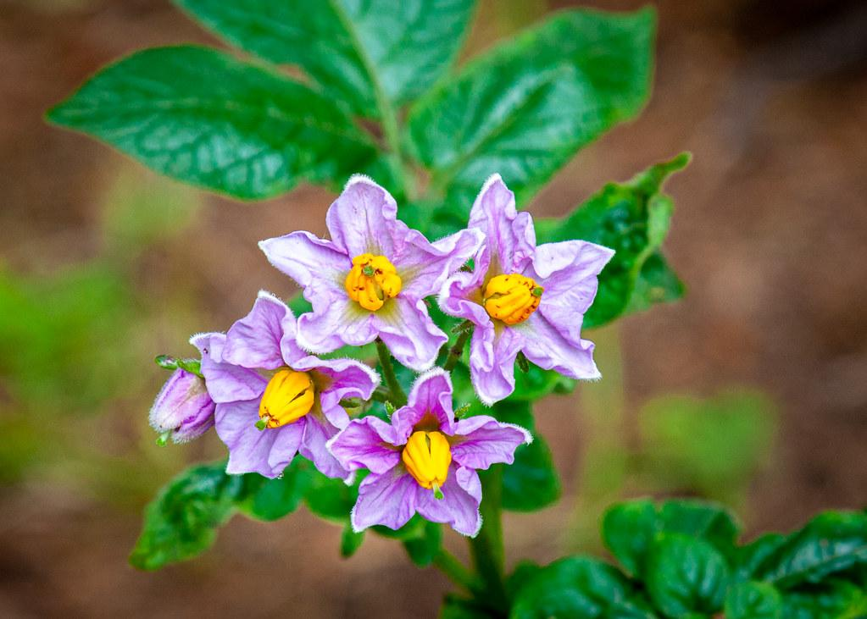
Intro to Team
Jazmyne
Damaris
Alicia
Rashini
Coding, coding presenter
Slides presenter, moccasins research
Coding explanations, coding
Slides formatting, Claire Heckle’s Data research

Slide 3
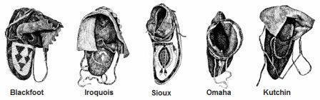
Moccasins:
Moccasins were the footwear most worn by Native Americans
The word was originated from the Algonquin word “makisin” meaning shoe.
They were made of soft leather and had no heel which made it easier for nomadic Indians to hunt and gather.
Each tribe had its own style of making moccasins, which helped Native Americans to identify a tribe by their footmarks on the ground.
Notes:
Rashini
The type of moccasins depended on the time of year.
Traditional moccasins were shoes made of deerskin, or other soft leather, the sole and upper part being one piece. They were sewn and secured by strong sinew or buckskin. Additional interesting information and facts, together with pictures of moccasins, are described in this article.

Slide 4
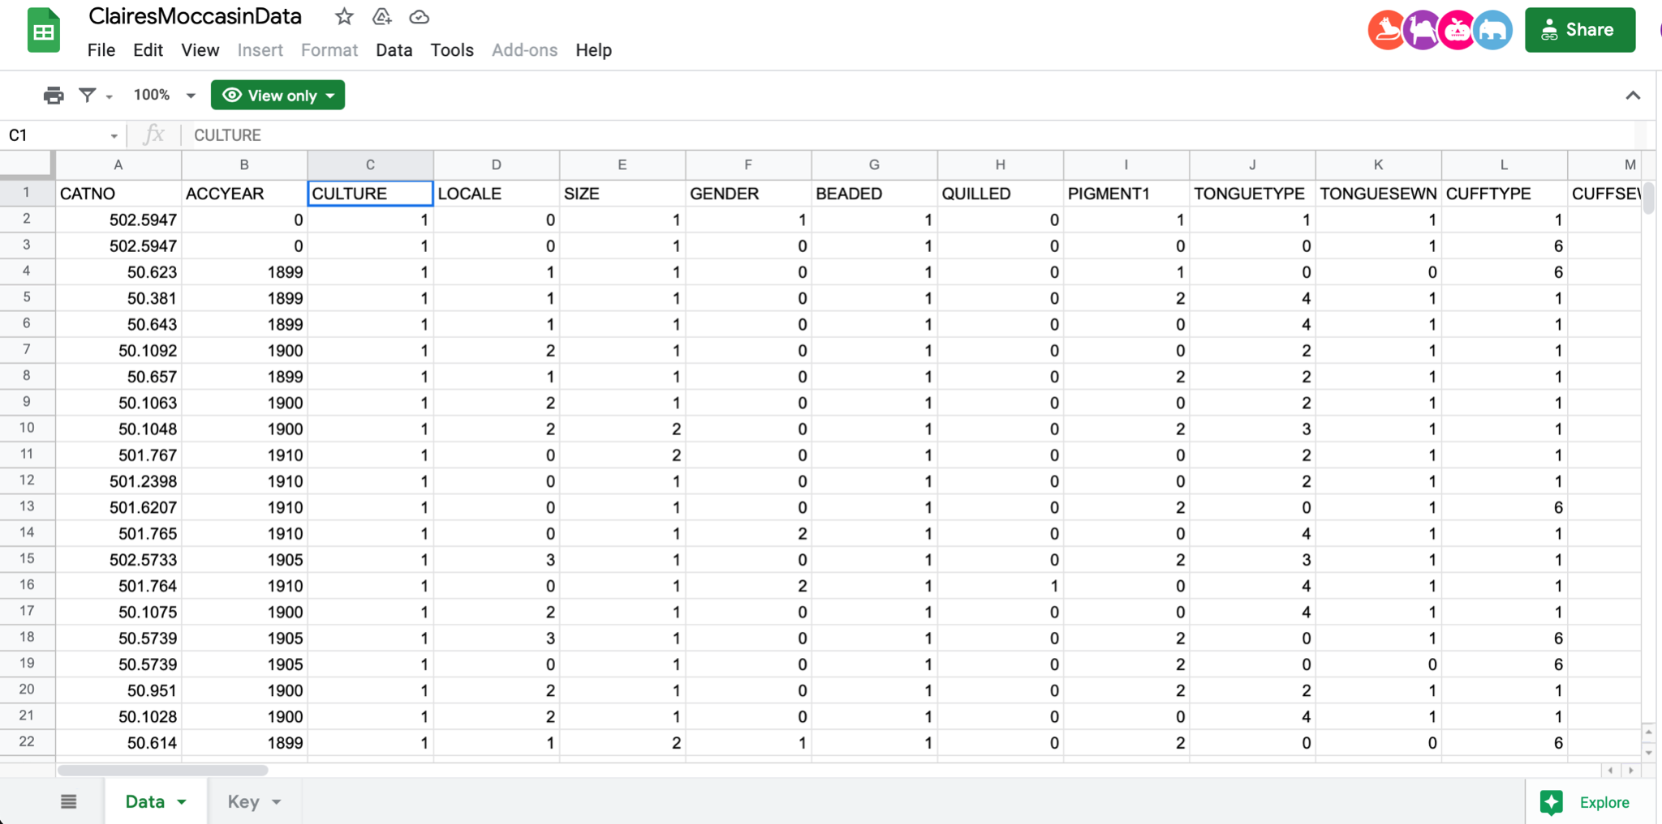
Intro to Claire Heckel’s Data:
Claire Heckel is an archaeologist who studied and researched science in the study of prehistoric art. She created a data set based of her research, to show how the moccasins structures changed and developed over time. The data sets include characteristics such as cultures, genders, size, pigments, and laces, etc. According to the data, over the years, the number of cultures that wore moccasins increased.
Notes:
Rashini
Claire heckel created a data set based of her research, to show how the moccasins structures changed and developed over time.

Slide 5
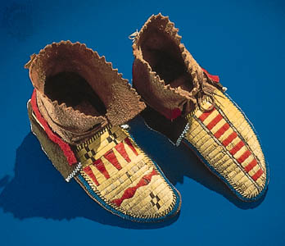
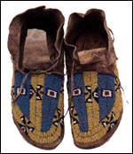
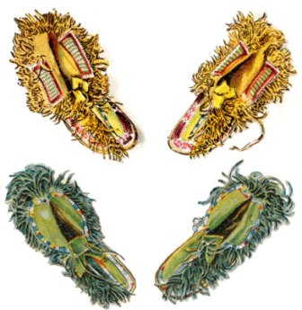
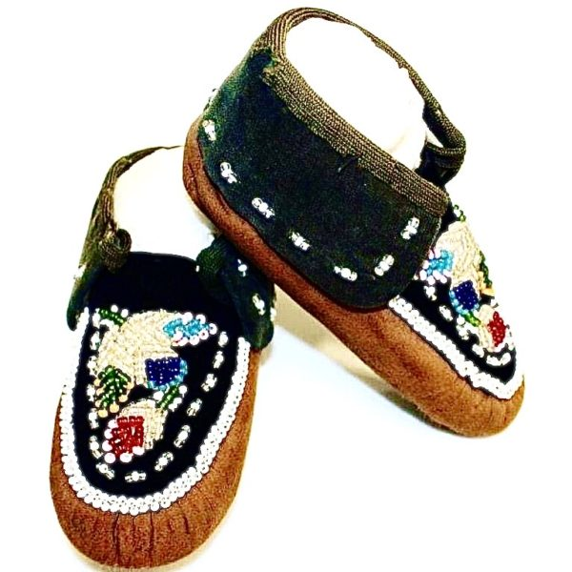
Hypothesis:
We feel that the primary colors will appear the most in the moccasins because red seems to be a very prominent color in Native American heritage and the green and the blue signify their link with nature.
Notes:
Damaris

Slide 6
Project Goal:
Why Code?
Our project goal was to explore the different color combinations and motifs for moccasins using Claire Heckel’s data.
Using code helped us to handle all of Claire Heckel’s data more efficiently, then if we were to analyze each piece of moccasin data individually.
Notes:
Damaris

Slide 7
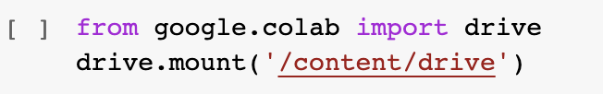
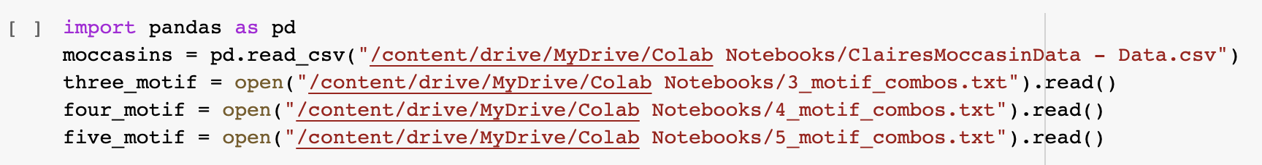
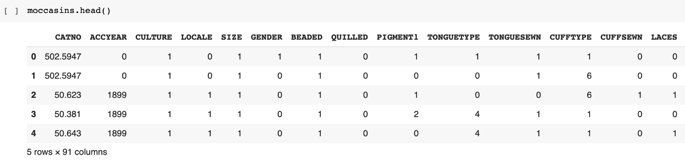
Code
Mounted the drive to have access to files
Imported the pandas dataframe to analyze the data
Open and read into the csv file
Used the .read() function to read data written to the file
Used the .head() function to display the first 5 rows
Notes:
Alicia

Slide 8
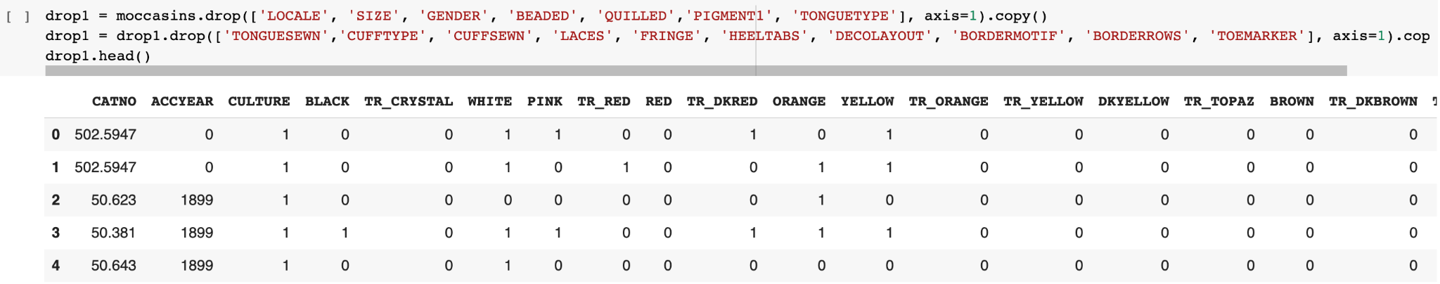
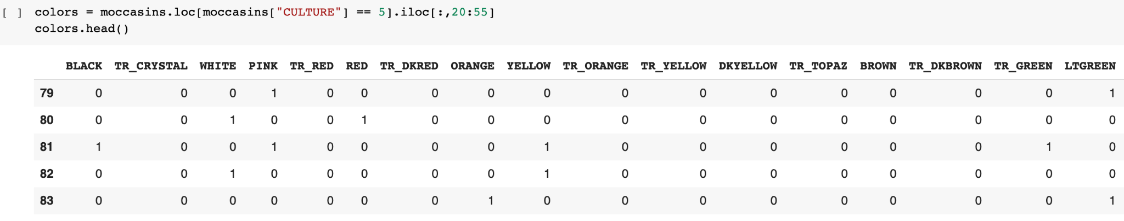
Code
Used the .drop() function to remove unnecessary columns, axis=1 for columns, the copy() method so no new parameters were added and return a new list.
Used the .head() function to display the first 5 rows
Used the loc attribute to isolate all the colors in the dataframe and all the moccasins that associate with the Plains Indians.
Used the .head() function to display the rows
Notes:
Damaris
We wanted to get rid of the columns that we didn’t need, so we used the drop() method to get rid of the first couple of columns, and placed it into a variable names drop 1. Then we used the .loc attribute to isolate all of the colors in the dataframe and all the moccasins that correlate with the plains Indians. And we used the .head() method to show both datasets.

Slide 9
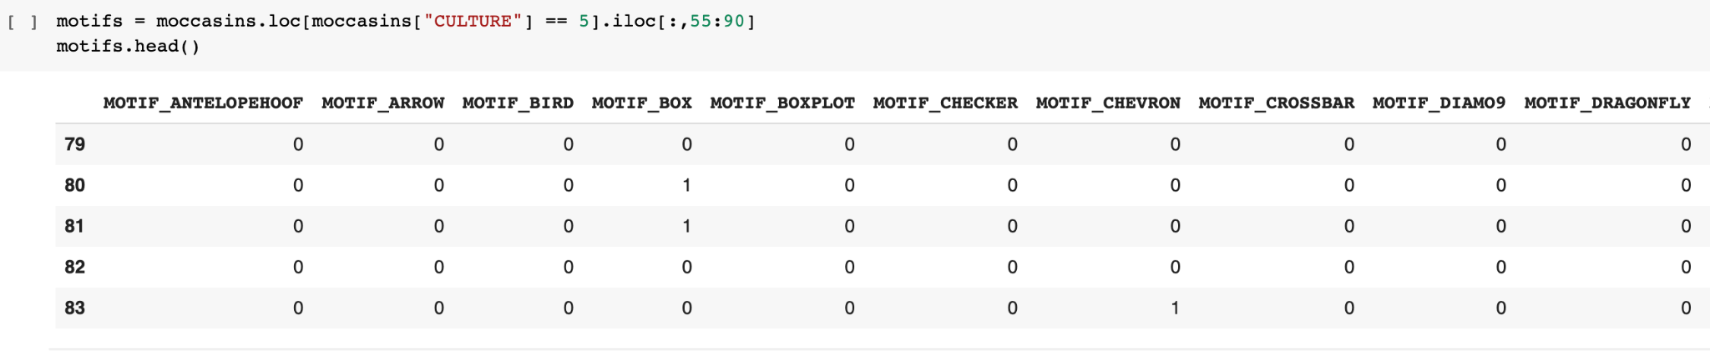
Code
Used the loc attribute to get the 5 rows with the “CULTURE” label. Used the .iloc attribute to get the rows at the specified index.
Used the head() function to display the rows
Notes:
Rashini
We just uploaded the color combination files and assigned them to variables

Slide 10
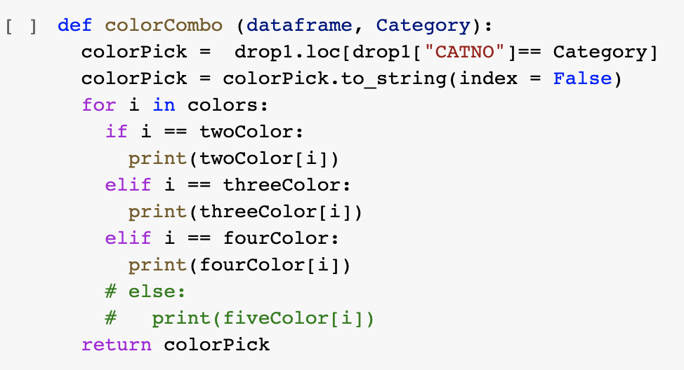
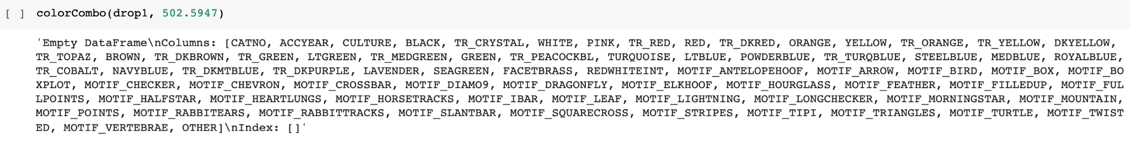
Code
Defined the function, followed by the parameters
Used .loc attribute to access the “CATNO” row from the adjusted data from the drop1 function
Notes:
Jazmyne
The top is a continuation of inserting the color combo text files. And now heres our function! Our initial thoughts for the function was to insert a category number for a moccasin and then the function would find the color combination it is most similar to and print it out. But our function ran into some issues. As you can see, from running our function we got an unwanted result and we couldn’t figure out what we needed to change to get the right result. We included the five color combination file but ran into an issue involving exceeding our data limit so we just commented it out of the function.

Slide 11
Conclusions
We are unsure if our hypothesis was correct or not
We need more time to better understand the project
Communication is key
Notes:
Jazmyne
After doing all of the project work we could, we came to some final conclusions: Since our coding was not successful, we dont know if our hypothesis about the abundant moccasin colors was correct or not. The next conclusion we had was that we need more time. We spent time trying to work out our plans of execution, but we needed more time to actually try more things out on our code so we could get successful results. And lastly communication is key. Although we did not have any communication problems working on this project, we realized the importance of communication especially during this time of confusion we had. Through communication we were able to talk out our ideas and help each other put their ideas on the screen

Slide 12
Challenges Solutions
Our first challenge was trying to figure out how to go about the task
Our biggest challenge was trying to figure out the “perfect” function and trying to get it to work
We came together as a group and brainstormed what we should do to go about the challenge
We have not yet found the “perfect” function, but we did still try our hardest using trial and error
Notes:
Alicia - solutions
Rashini - challenges
Initially, we were having trouble interpreting what the questions were asking us to do, so we were feeling stressed because we couldn’t start the challenging task.
Our biggest challenge was coming up with the function, from our brainstorming session we came up with a few approaches to making the function in hopes that they would work, but when it came down to running them, they did not work.

Slide 13
Next Steps
More time to work on the function
Use the results to bring attention to Indigenous culture
Notes:
Damaris
Overall, in the future we would like to have more time to work on the function and execute it. We had multiple errors, and if we had more time to figure out how to solve those errors, we think our project would have been more successful. We also would like to use the results from the project to bring more attention to Indigenous culture because sadly, it is a population that is slowly decreasing, and the more we can preserve the artifacts and heritage, the more we can keep that culture alive.

Slide 14

Notes:
Jazmyne

